Slide 1

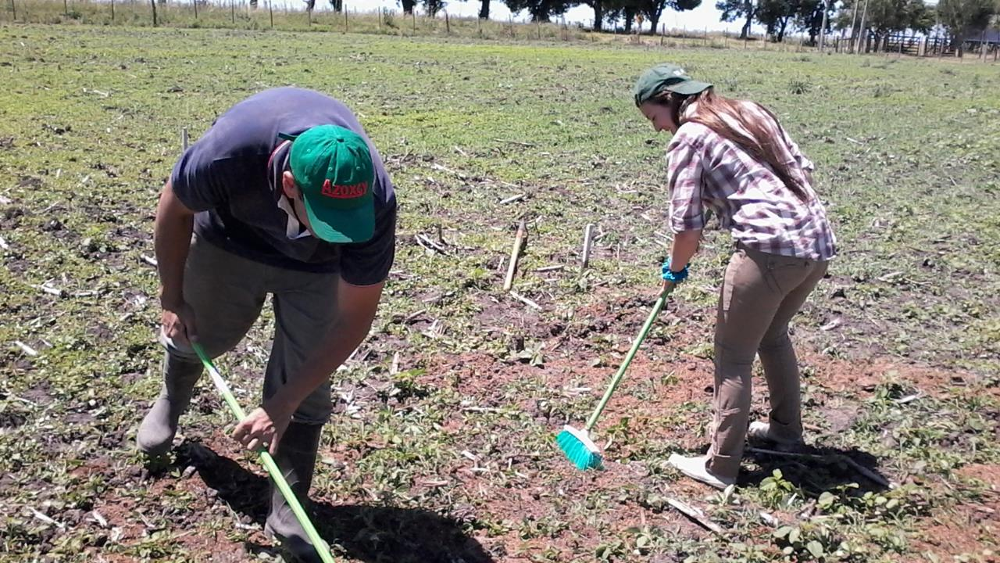
Non lineal regressions The general Laws of Growth
Germán Fernández

Slide 2
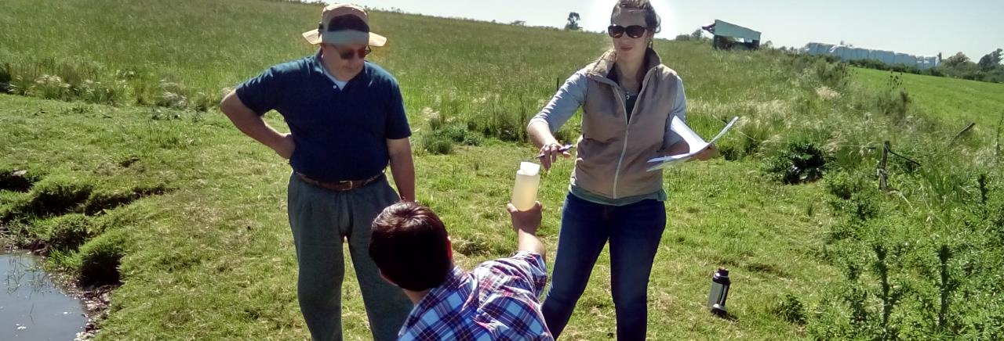
Context
Data is part of the research project:
INIA-FPTA 333 Proy. 86
Evaluación agronómica y de impacto ambiental en suelos y aguas, debido al uso de la cama de pollo como fertilizante o enmienda orgánica con diferentes grados de procesamiento.

Slide 3
Context
Data is part of the research project:
INIA-FPTA 333 Proj. 86
Agronomic and environmental impact assessment on soils and waters, due to the use of chicken litter as a fertilizer or organic amendment with different degrees of processing.

Slide 4
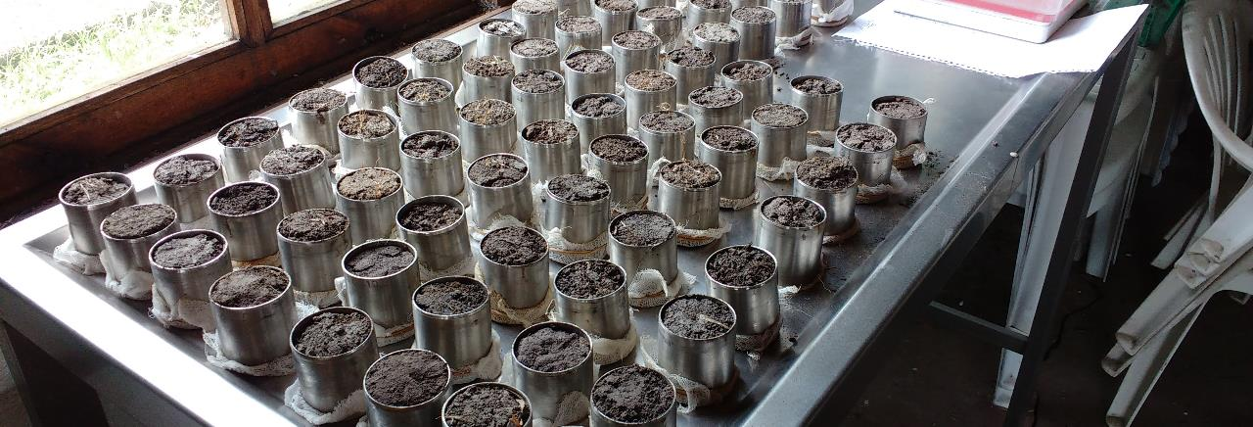
Context
Data is part of the research project:
INIA-FPTA 333 Proj. 86
Component 1
Component 2
Component 3
Component 4
Experiment 1
Experiment 2
Experiment 3
Year 1
Year 2
Year 3
Maize
Oatmeal

Slide 5
Context
Data is part of the reaserch proyect:
INIA-FPTA 333 Proy. 86
Maize
Chapter:
6.1.1 Dry matter accumulation
Undergrad thesis

Slide 6
FPTA 333 Proj. 86 Component 3 Experiment 2 Year 1 Crop 1 Maize Thesis
Experimental Design
The experimental variables were: three doses of poultry litter based on its N supply (0, 180 and 360 kg N ha-1) and three doses of urea (0, 90 and 180 kg N ha-1), combined in a factorial design, establishing three blocks associated with soil differences.
Treatment | Urea | Chicken litter
 | Kg N ha⁻¹
1 | 0 | 0
2 | 0 | 180
3 | 0 | 360
4 | 90 | 0
5 | 90 | 180
6 | 90 | 360
7 | 180 | 0
8 | 180 | 180
9 | 180 | 360

Slide 7
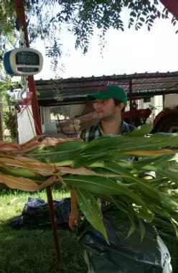

The general Laws of Growth
Sigmoidal curves
Formula
S-shaped growth curve(sigmoid growth curve) A pattern of growth in which, in a new environment, the population density of an organism increases slowly initially, in a positive acceleration phase; then increases rapidly, approaching an exponential growth rate as in the J-shaped curve; but then declines in a negative acceleration phase until at zero growth rate the population stabilizes.
$$y=a+\frac{b −a}{1+e^{−c\left(x −d\right)}}$$
Shape of the formula

Slide 8
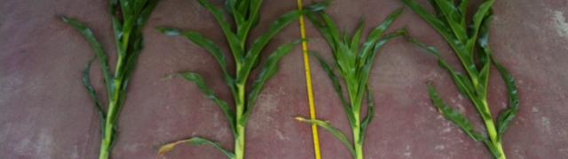
Non lineal regression
Nonlinear regression is a form of regression analysis in which observational data are modeled by a function which is a nonlinear combination of the model parameters and depends on one or more independent variables. The data are fitted by a method of successive approximations.

Slide 9
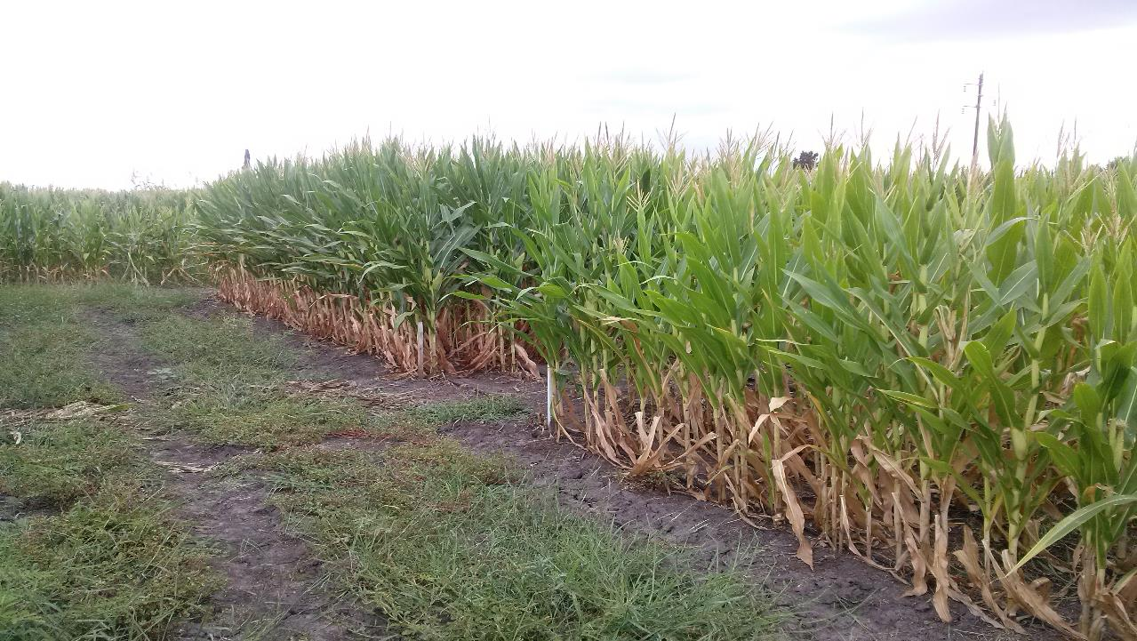
Switch to R

Slide 10
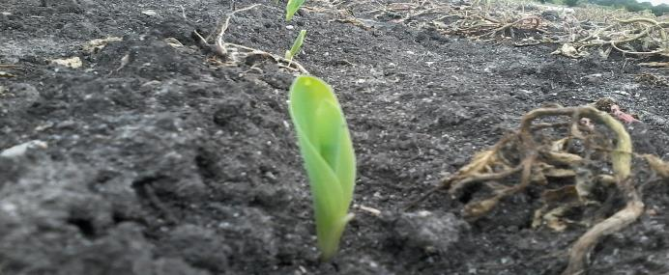
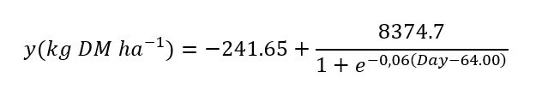
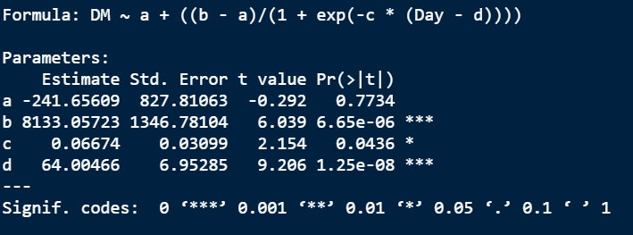
Data interpretation

Slide 11

Thank you

